Slide 1
Grade 5 Final Assessment
Term 3

Slide 4
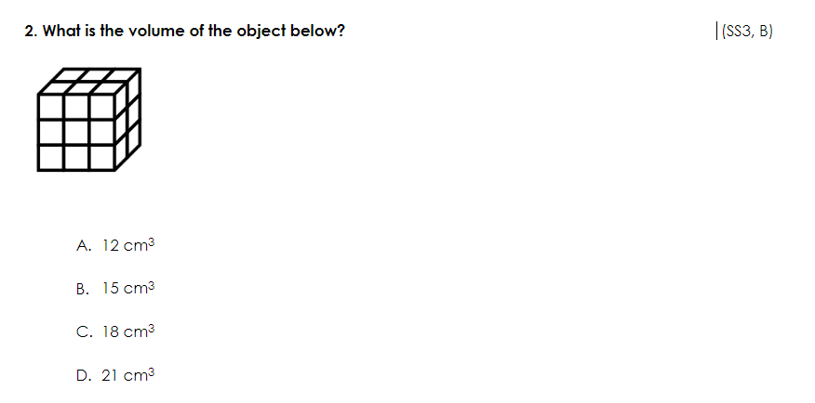

Slide 8
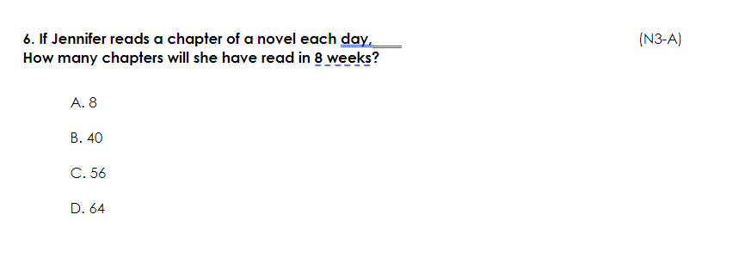

Slide 10
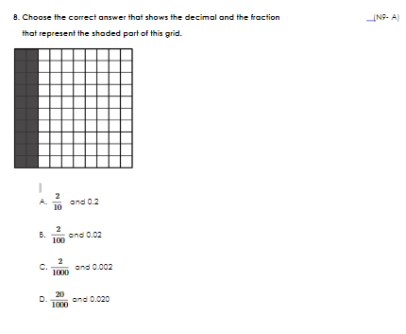

Slide 15
