Slide 1
Grade 4 Assessment
Term 3

Slide 9
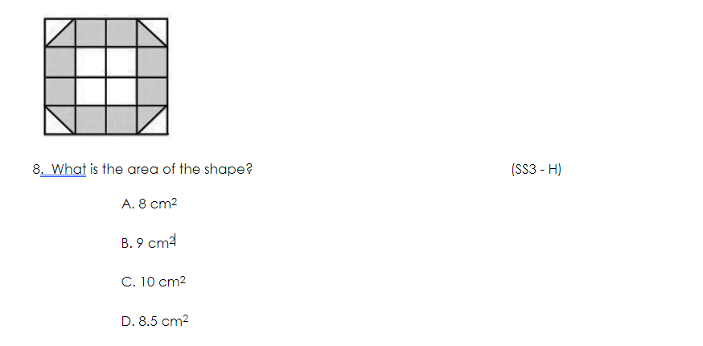

Slide 10
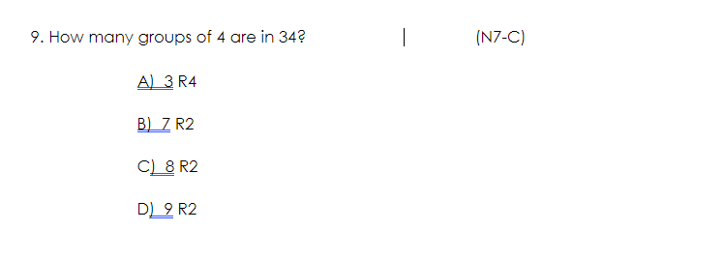

Slide 12
